Slide 1
Machine Learning with TensorFlow
Rashika Koul
Notes:
Due on 7th May
https://www.tensorflow.org/

Slide 2
Introduction to Machine Learning
Machine learning (ML) is the scientific study of algorithms and statistical models that computer systems use to effectively perform a specific task without using explicit instructions, relying on patterns and inference instead. It is seen as a subset of artificial intelligence. Machine learning algorithms build a mathematical model based on sample data, known as "training data", in order to make predictions or decisions without being explicitly programmed to perform the task.
The types of machine learning algorithms differ in their approach, the type of data they input and output, and the type of task or problem that they are intended to solve.

Slide 3
Supervised Learning
Supervised learning algorithms build a mathematical model of a set of data that contains both the inputs and the desired outputs. The data is known as training data, and consists of a set of training examples. Each training example has one or more inputs and a desired output, also known as a supervisory signal. In the case of semi-supervised learning algorithms, some of the training examples are missing the desired output. Through iterative optimization of an objective function, supervised learning algorithms learn a function that can be used to predict the output associated with new inputs.
Supervised learning algorithms include classification and regression. Classification algorithms are used when the outputs are restricted to a limited set of values, and regression algorithms are used when the outputs may have any numerical value within a range.

Slide 4
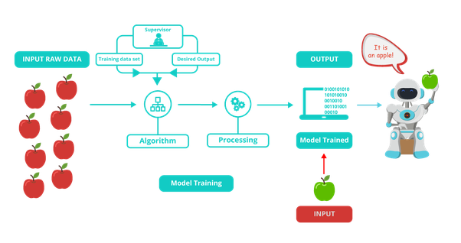
Supervised Learning

Slide 5
Unsupervised Learning
Unsupervised learning algorithms take a set of data that contains only inputs, and find structure in the data, like grouping or clustering of data points. The algorithms therefore learn from test data that has not been labeled, classified or categorized. Instead of responding to feedback, unsupervised learning algorithms identify commonalities in the data and react based on the presence or absence of such commonalities in each new piece of data.
Cluster analysis is the assignment of a set of observations into subsets (called clusters) so that observations within the same cluster are similar according to one or more predesignated criteria, while observations drawn from different clusters are dissimilar. Different clustering techniques make different assumptions on the structure of the data, often defined by some similarity metric and evaluated, for example, by internal compactness, or the similarity between members of the same cluster, and separation, the difference between clusters. Other methods are based on estimated density and graph connectivity.

Slide 6
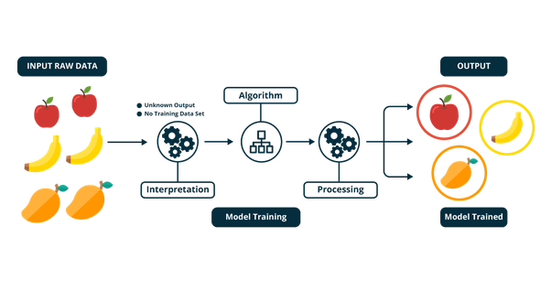
Unsupervised Learning

Slide 7
Reinforcement Learning
Reinforcement learning is an area of machine learning concerned with how software agents ought to take actions in an environment so as to maximize some notion of cumulative reward. Due to its generality, the field is studied in many other disciplines, such as game theory, control theory, operations research, information theory, simulation-based optimization, multi-agent systems, swarm intelligence, statistics and genetic algorithms. In machine learning, the environment is typically represented as a Markov Decision Process (MDP). Many reinforcement learning algorithms use dynamic programming techniques. Reinforcement learning algorithms do not assume knowledge of an exact mathematical model of the MDP, and are used when exact models are infeasible. Reinforcement learning algorithms are used in autonomous vehicles or in learning to play a game against a human opponent.

Slide 8
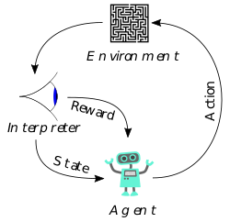
Reinforcement Learning

Slide 9
Models-Artificial neural networks
Artificial neural networks (ANNs), are models based on a collection of connected units or nodes called "artificial neurons". Each connection, can transmit information, a "signal", from one artificial neuron to another. An artificial neuron that receives a signal can process it and then signal additional artificial neurons connected to it. In common ANN implementations, the signal at a connection between artificial neurons is a real number, and the output of each artificial neuron is computed by some non-linear function of the sum of its inputs such as a sigmoid function. The connections between artificial neurons are called "edges". Artificial neurons and edges typically have a weight that adjusts as learning proceeds. Deep learning consists of multiple hidden layers in an artificial neural network.

Slide 10
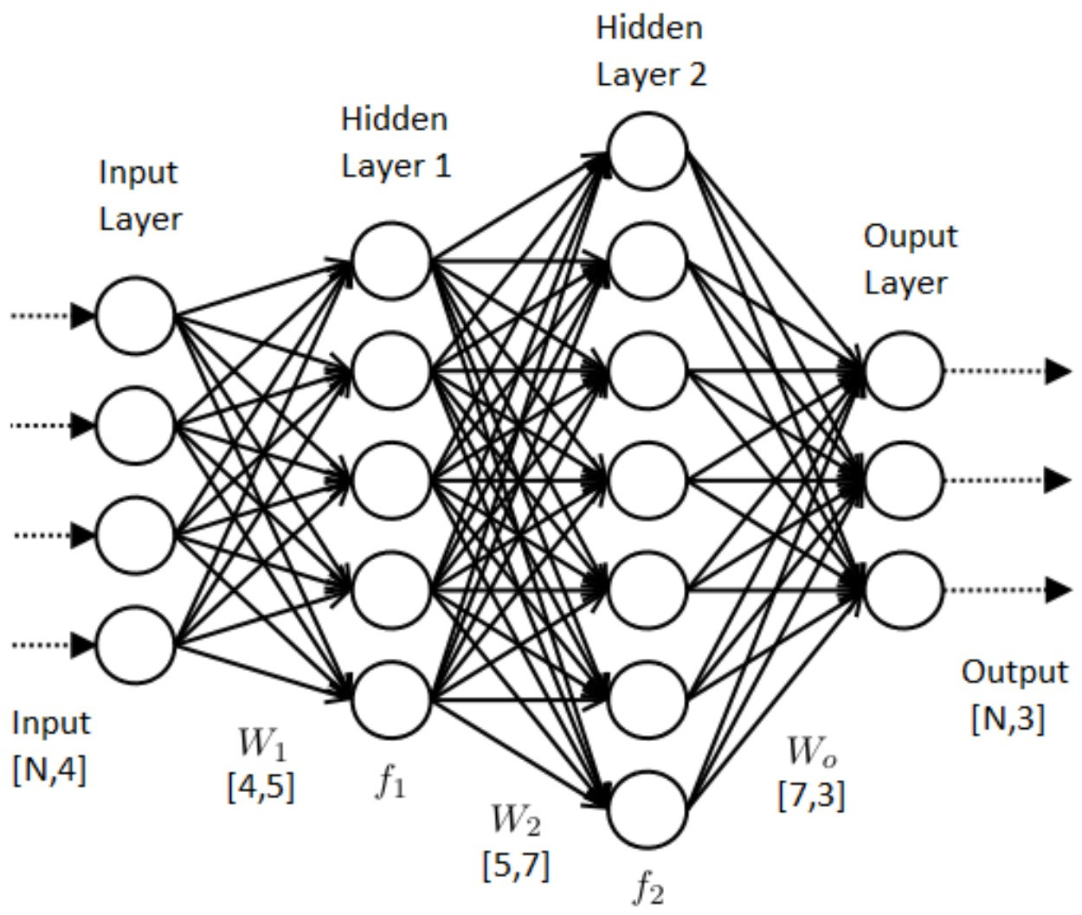
Models-Artificial neural networks

Slide 11
Models- Support vector machines (SVMs)
Support vector machines (SVMs), also known as support vector networks, are a set of related supervised learning methods used for classification and regression. Given a set of training examples, each marked as belonging to one of two categories, an SVM training algorithm builds a model that predicts whether a new example falls into one category or the other. An SVM training algorithm is a non-probabilistic, binary, linear classifier, although methods such as Platt scaling exist to use SVM in a probabilistic classification setting. In addition to performing linear classification, SVMs can efficiently perform a non-linear classification using what is called the kernel trick, implicitly mapping their inputs into high-dimensional feature spaces.

Slide 12
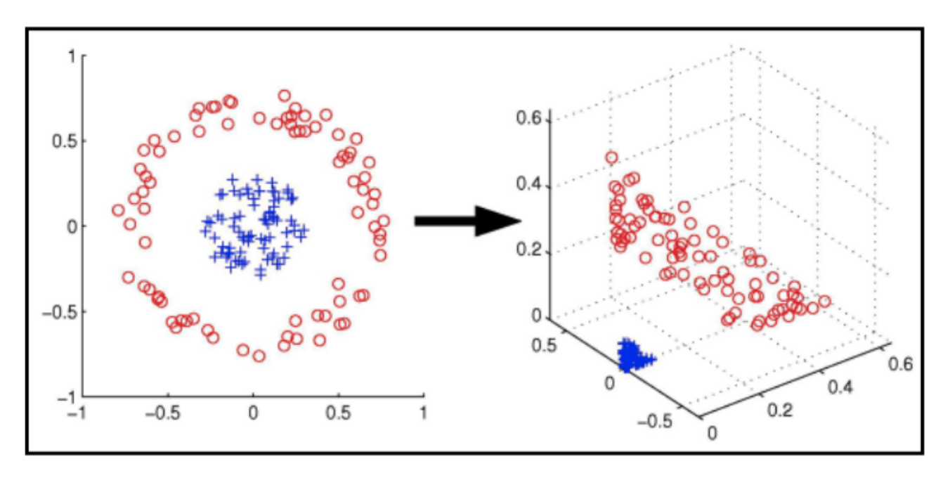
Models- Support vector machines (SVMs)

Slide 13
Models- Bayesian Network and Genetic Algorithm
A Bayesian network, belief network or directed acyclic graphical model is a probabilistic graphical model that represents a set of random variables and their conditional independence with a directed acyclic graph (DAG). Efficient algorithms exist that perform inference and learning. Bayesian networks that model sequences of variables, like speech signals or protein sequences, are called dynamic Bayesian networks.
A genetic algorithm (GA) is a search algorithm and heuristic technique that mimics the process of natural selection, using methods such as mutation and crossover to generate new genotypes in the hope of finding good solutions to a given problem.

Slide 14
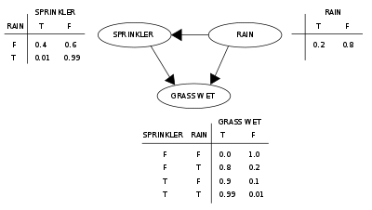
Models- Bayesian Network and Genetic Algorithm

Slide 15
Introduction to TensorFlow
TensorFlow is a free and open-source software library for dataflow and differentiable programming across a range of tasks. It is a symbolic math library, and is also used for machine learning applications such as neural networks.
Initially, TensorFlow was developed by the Google Brain team for internal Google use. It was released under the Apache 2.0 open-source license on November 9, 2015.

Slide 16
History of TensorFlow
TensorFlow is Google Brain's second-generation system. Version 1.0.0 was released on February 11, 2017. While the reference implementation runs on single devices, TensorFlow can run on multiple CPUs and GPUs. TensorFlow is available on 64-bit Linux, macOS, Windows, and mobile computing platforms including Android and iOS.
Its flexible architecture allows for the easy deployment of computation across a variety of platforms (CPUs, GPUs, TPUs), and from desktops to clusters of servers to mobile and edge devices.
TensorFlow computations are expressed as stateful dataflow graphs. The name TensorFlow derives from the operations that such neural networks perform on multidimensional data arrays, which are referred to as tensors.

Slide 17

Applications of TensorFlow
Voice/Sound Recognition
Text Based Applications
Image Recognition
Time Series
Video Detection
Computer Vision
Machine Learning
Deep Learning

Slide 18
Features of TensorFlow
TensorFlow provides stable Python and C APIs; and without API backwards compatibility guarantee: C++, Go, Java, JavaScript and Swift (early release). Third party packages are available for C#, Haskell, Julia, R, Scala, Rust, OCaml, and Crystal.
Some companies that use TensorFlow are Airbnb, Cocacola, Intel, GE Healthcare, Google, Twitter etc.

Slide 19
Why TensorFlow
Whether you’re an expert or a beginner, TensorFlow is an end-to-end platform that makes it easy for you to build and deploy ML models.
Easy Model Building
TensorFlow offers multiple levels of abstraction so you can choose the right one for your needs. Build and train models by using the high-level Keras API, which makes getting started with TensorFlow and machine learning easy.
If you need more flexibility, eager execution allows for immediate iteration and intuitive debugging. For large ML training tasks, use the Distribution Strategy API for distributed training on different hardware configurations without changing the model definition.

Slide 20
Why TensorFlow Continued
Robust ML Production anywhere
TensorFlow has always provided a direct path to production. Whether it’s on servers, edge devices, or the web, TensorFlow lets you train and deploy your model easily, no matter what language or platform you use.
Use TensorFlow Extended (TFX) if you need a full production ML pipeline. For running inference on mobile and edge devices, use TensorFlow Lite. Train and deploy models in JavaScript environments using TensorFlow.js.

Slide 21
Why TensorFlow Continued
Powerful Experimentation for Research
Build and train state-of-the-art models without sacrificing speed or performance. TensorFlow gives you the flexibility and control with features like the Keras Functional API and Model Subclassing API for creation of complex topologies. For easy prototyping and fast debugging, use eager execution.
TensorFlow also supports an ecosystem of powerful add-on libraries and models to experiment with, including Ragged Tensors, TensorFlow Probability, Tensor2Tensor and BERT.

Slide 22
TensorFlow Libraries and Extensions
Probability:
TensorFlow Probability is a library for probabilistic reasoning and statistical analysis.
Tensor2Tensor:
Tensor2Tensor is a library of deep learning models and datasets designed to make deep learning more accessible and accelerate ML research.
Mesh TensorFlow:
A language for distributed deep learning, capable of specifying a broad class of distributed tensor computations.

Slide 23
TensorFlow Libraries and Extensions Continued
TensorFlow Agents:
A library for reinforcement learning in TensorFlow.
TensorFlow Federated:
An open source framework for machine learning and other computations on decentralized data.
TensorFlow Privacy:
A Python library that includes implementations of TensorFlow optimizers for training machine learning models with differential privacy.

Slide 24
TensorFlow Libraries and Extensions Continued
Dopamine:
A research framework for fast prototyping of reinforcement learning algorithms.
TRFL:
TRFL (pronounced “truffle”) is a library for reinforcement learning building blocks created by DeepMind.
RaggedTensors:
Makes it easy to store and manipulate data with non-uniform shape, including text (words, sentences, characters), and batches of variable length.

Slide 25
TensorFlow Libraries and Extensions Continued
Unicode Ops:
Supports working with Unicode text directly in TensorFlow.
TensorFlow Ranking:
TensorFlow Ranking is a library for Learning-to-Rank (LTR) techniques on the TensorFlow platform.
Magenta:
Magenta is a research project exploring the role of machine learning in the process of creating art and music.

Slide 26
TensorFlow Libraries and Extensions Continued
Nucleus:
Nucleus is a library of Python and C++ code designed to make it easy to read, write and analyze data in common genomics file formats like SAM and VCF.
Sonnet:
A library from DeepMind for constructing neural networks.

Slide 27
TensorFlow Tools
Some tools to support and accelerate TensorFlow workflows:
CoLab:
Colaboratory is a free Jupyter notebook environment that requires no setup and runs entirely in the cloud, allowing you to execute TensorFlow code in your browser with a single click.
TensorBoard:
A suite of visualization tools to understand, debug, and optimize TensorFlow programs.

Slide 28
TensorFlow Tools Continued
What-If Tool:
A tool for code-free probing of machine learning models, useful for model understanding, debugging, and fairness. Available in TensorBoard and jupyter or colab notebooks.
ML Perf:
A broad ML benchmark suite for measuring performance of ML software frameworks, ML hardware accelerators, and ML cloud platforms.

Slide 29
TensorFlow Tools Continued
XLA:
XLA (Accelerated Linear Algebra) is a domain-specific compiler for linear algebra that optimizes TensorFlow computations. The results are improvements in speed, memory usage, and portability on server and mobile platforms.
TensorFlow Playground:
Tinker with a neural network in your browser. Don’t worry, you can’t break it.

Slide 30
TensorFlow Tools Continued
The TensorFlow Research Cloud:
The TensorFlow Research Cloud (TFRC) program enables researchers to apply for access to a cluster of more than 1,000 Cloud TPUs at no charge to help them accelerate the next wave of research breakthroughs.

Slide 31
Models and Datasets
Explore repositories and other resources to find available models, modules and datasets created by the TensorFlow community.
Models:
TensorFlow official models- Official models and examples built with TensorFlow.
TensorFlow Hub- TensorFlow Hub is a library to foster the publication, discovery, and consumption of reusable parts of machine learning models.
Datasets:
TensorFlow official datasets- A collection of datasets ready to use with TensorFlow.

Slide 32
Models and Datasets Continued
Google research datasets- Explore large-scale datasets released by Google research teams in a wide range of computer science disciplines.
Additional dataset resources- Google cloud public datasets, Kaggle datasets

Slide 33
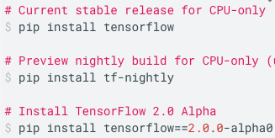
Install TensorFlow
Tensorflow is tested and supported for the following 64-bit systems:
Ubuntu 16.04 or later
macOS 10.12.6 (Sierra) or later (no GPU support)
Windows 7 or later
Raspbian 9.0 or later
Install TensorFlow with Python's pip package manager.

Slide 34
TensorFlow Guide
This will cover the following topics:
High Level APIs
Estimators
Accelerators
Low Level APIs
ML Concepts
Debugging
Performance
Extend
Misc

Slide 35
High Level APIs
Keras
TensorFlow's high-level API for building and training deep learning models.
Eager Execution
an API for writing TensorFlow code imperatively, like you would use Numpy.
Importing Data
easy input pipelines to bring your data into your TensorFlow program.

Slide 36
High Level APIs Continued
Estimators
a high-level API that provides fully-packaged models ready for large-scale training and production.

Slide 37
Estimators
Premade Estimators
The basics of premade Estimators.
Checkpoints
Save training progress and resume where you left off.
Feature Columns
Handle a variety of input data types without changes to the model.
Datasets for Estimators
Use tf.data to input data.
Creating Custom Estimators
Write your own Estimator.

Slide 38
Accelerators
Using GPUs explains how TensorFlow assigns operations to devices and how you can change the arrangement manually.
Using TPUs explains how to modify Estimator programs to run on a TPU.

Slide 39
Low Level APIs
Introduction, which introduces the basics of how you can use TensorFlow outside of the high Level APIs.
Tensors, which explains how to create, manipulate, and access Tensors--the fundamental object in TensorFlow.
Variables, which details how to represent shared, persistent state in your program.
Graphs and Sessions, which explains:
dataflow graphs, which are TensorFlow's representation of computations as dependencies between operations.

Slide 40
Low Level APIs Continued
sessions, which are TensorFlow's mechanism for running dataflow graphs across one or more local or remote devices. If you are programming with the low-level TensorFlow API, this unit is essential. If you are programming with a high-level TensorFlow API such as Estimators or Keras, the high-level API creates and manages graphs and sessions for you, but understanding graphs and sessions can still be helpful.
Save and Restore, which explains how to save and restore variables and models.
Ragged Tensors, which explains how to use Ragged Tensors to encode nested variable-length lists.

Slide 41
ML Concepts
Embeddings, which introduces the concept of embeddings, provides a simple example of training an embedding in TensorFlow, and explains how to view embeddings with the TensorBoard Embedding Projector.

Slide 42
Debugging
TensorFlow Debugger, which explains how to use the TensorFlow debugger (tfdbg).

Slide 43
Performance
Performance is an important consideration when training machine learning models. Performance speeds up and scales research while also providing end users with near instant predictions.
Performance overview contains a collection of best practices for optimizing your TensorFlow code.
Data input pipeline describes the tf.data API for building efficient data input pipelines for TensorFlow.
Benchmarks contain a collection of benchmark results for a variety of hardware configurations.
Additionally, TensorFlow Lite has optimization techniques for mobile and embedded devices.

Slide 44
Extend
This section explains how developers can add functionality to TensorFlow's capabilities.
TensorFlow architecture presents an architectural overview.
Create an op, which explains how to create your own operations.
Custom filesystem plugin, which explains how to add support for your own shared or distributed filesystem.
Custom file and record formats, which details how to add support for your own file and record formats.
Language bindings, Python is currently the only language supported by TensorFlow's API stability promises. However, TensorFlow also provides functionality to create or develop features in other languages.
Model files, for creating tools compatible with TensorFlow's model format.

Slide 45
Misc
TensorFlow Version Compatibility, which explains backward compatibility guarantees and non-guarantees.
Frequently Asked Questions, which contains frequently asked questions about TensorFlow.

Slide 46
References
https://en.wikipedia.org/w/index.php?title=Machine_learning&oldid=894762083
https://www.tensorflow.org
https://en.wikipedia.org/w/index.php?title=TensorFlow&oldid=894748660
https://medium.com/@gowthamy/machine-learning-supervised-learning-vs-unsupervised-learning-f1658e12a780
https://en.wikipedia.org/w/index.php?title=Reinforcement_learning&oldid=895068017
https://en.wikipedia.org/wiki/Bayesian_network
https://medium.com/@zachary.bedell/support-vector-machines-explained-73f4ec363f13
https://medium.com/coinmonks/the-artificial-neural-networks-handbook-part-1-f9ceb0e376b4

